Slide 1
Feature Engineering
Jaya Sil

Slide 2
Introduction
In machine learning and pattern recognition, a feature is an individual measurable property or characteristic of a phenomenon being observed.
A common way to represent data objects for data analytics is to use feature vectors.
Choosing informative, discriminating and independent features is a crucial step for effective algorithms in pattern recognition.
Feature generation is the process of creating new features from one or multiple features.

Slide 3
Feature Engineering
Feature Engineering, also known as feature creation, is a manual process, relying on domain knowledge, intuition, and data manipulation.
Automated feature engineering aims to creating many candidate features automatically out of a dataset.
This process adds new information when there is a feature interaction, therefore result in more accurate model.
This step can be more important than the actual model used because a machine learning algorithm only learns from the data we give it, and creating features that are relevant to a task is absolutely crucial.

Slide 4
Automatic Feature engineering
The feature engineering field contains a variety of issues and tasks.
The most representative issues and tasks are feature transformation, feature generation and extraction, feature selection, automatic feature engineering, and feature analysis and evaluation.
Automatic feature engineering is about generic approaches for automatically generating a large number of features and selecting an effective subset of the generated features in the process.
Feature engineering has large impact on two of the most frequently used types of data, namely text data and image data.

Slide 5
Feature engineering
Feature engineering requires extracting the relevant information from the data.
The process is very time-consuming, especially when using information from more than one table.
We can group the operations of feature creation into two categories: transformations and aggregations.
A transformation acts on a single table.
Aggregations are performed across tables, and use a one-to-many relationship to group observations

Slide 6
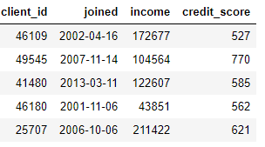
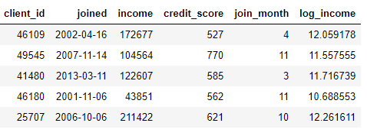

Slide 7
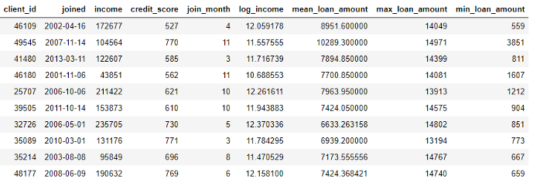
Another table with information on the loans of clients, where each client may have multiple loans, we calculate average, maximum, and minimum of loans for each client.

Slide 8
Text feature extraction
Machine learning algorithms cannot work on the raw text directly.
So, we need some feature extraction techniques to convert text into a matrix(or vector) of features.
Text as strings, the sequence of words representation, the bag of words representation, term weighting, structural representation of text, semantic structure features, latent semantic representation, word embeddings for text representation, and context-sensitive text representation
Text feature extraction are :
Bag-of-Words
TF-IDF

Slide 9
Text Feature
The importance of feature engineering is important for unstructured, textual data.
We need to convert text into some numeric representations which can then be understood by machine learning algorithms.
Free flowing text in the form of words, phrases, sentences and entire documents.
Essentially, we do have some syntactic structure like words make phrases, phrases make sentences which in turn make paragraphs.
However, there is no inherent structure to text documents.
A wide variety of words are across the documents and each sentence have variable length as compared to a fixed number of data dimensions in structured datasets.

Slide 10
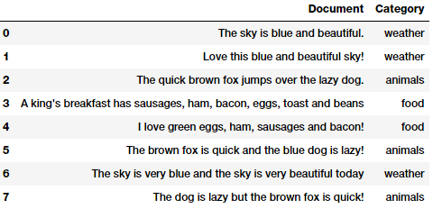
corpus
A corpus is typically a collection of text documents usually belonging to one or more subjects.
We need to do some data pre-processing or wrangling to remove unnecessary characters, symbols and tokens.

Slide 11
Text pre-processing
There can be multiple ways of cleaning and pre-processing textual data.
Removing tags: Our text often contains unnecessary content like HTML tags, which do not add much value when analyzing text.
Removing accented characters: Accented characters\letters are converted and standardized into ASCII characters, say converting é to e.
Expanding contractions: contractions are basically shortened versions of words or syllables. Examples: do not to don’t
Expanding helps text standardization

Slide 12
Text pre-processing
Removing stopwords: Words which have little or no significance especially when constructing meaningful features from text are known as stopwords or stop words.
Words like a, an, the, and so on are considered to be stopwords.
There is no universal stopword list but we use a standard English language stopwords list from nltk.
Other standard operations like tokenization, removing extra whitespaces, text lower casing and more advanced operations like spelling corrections, grammatical error corrections, removing repeated characters and so on.

Slide 13
Text pre-processing
Removing special characters: Special characters and symbols which are usually non alphanumeric characters often add to the extra noise in unstructured text.
Stemming and lemmatization: Word stems are usually the base form of possible words that can be created by attaching prefixes and suffixes to the stem to create new words. WATCHES, WATCHING, and WATCHED have the word root stem WATCH as the base form.
Lemmatization is very similar to stemming, where we remove word affixes to get to the base form of a word. The difference being that the root word is always a lexicographically correct word (present in the dictionary) but the root stem may not be so.

Slide 14
Bag of Words Model
Simple vector space representational model for unstructured text.
The bag of words model represents each text document as a numeric vector where each dimension is a specific word from the corpus and the value could be its frequency in the document, occurrence (denoted by 1 or 0) or even weighted values.
The model’s name is such because each document is represented literally as a ‘bag’ of its own words, disregarding word orders, sequences and grammar.

Slide 15
Bag of Words
Bag-of-Words (BoW) is one of the most fundamental methods to transform tokens into a set of features.
The BoW model is used in document classification, where each word is used as a feature.
For example, in a task of review based sentiment analysis, the presence of words like ‘fabulous’, ‘excellent’ indicates a positive review, while words like ‘annoying’, ‘poor’ point to a negative review .

Slide 16
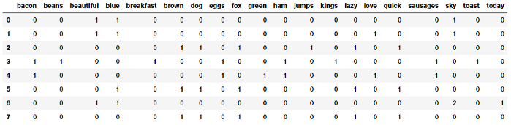
Each column or dimension in the feature vectors represents a word from the corpus and each row represents one of our documents.
The value in any cell, represents (represented by column) occurrence in the specific document (represented by row).

Slide 17
BoW model
If a corpus of documents consists of N unique words across all the documents, we would have an N-dimensional vector for each of the documents.
There are 3 steps while creating a BoW model :
text-preprocessing:
create a vocabulary of all unique words from the corpus.
Let’s suppose, we have a review text.
good movie
not a good movie
did not like

Slide 18
Text Vectorization
Consider all the unique words from the above set of reviews to create a vocabulary.
{good, movie, not, a, did, like}
In the third step, we create a matrix of features by assigning a separate column for each word, while each row corresponds to a review.
This process is known as Text Vectorization. Each entry in the matrix signifies the presence(or absence) of the word in the review.
We put 1 if the word is present in the review, and 0 if it is not present.

Slide 19
Good movie not a did like
1 1 0 0 0 0
1 1 1 1 0 0
0 0 1 0 1 1
A major drawback in using this model is that the order of occurence of words is lost, as we create a vector of tokens in randomised order.
However, we can solve this problem by considering N-grams(mostly bigrams) instead of individual words(i.e. unigrams).
This can preserve local ordering of words.

Slide 20
Bag of N-Grams Model
A word is just a single token, often known as a unigram or 1-gram.
An N-gram is basically a collection of word tokens from a text document such that these tokens are contiguous and occur in a sequence.
Bi-grams indicate N-grams of order 2 (two words), Tri-grams indicate N-grams of order 3 (three words), and so on.
The Bag of N-Grams model is an extension of the Bag of Words model where we consider N-gram based features.

Slide 21
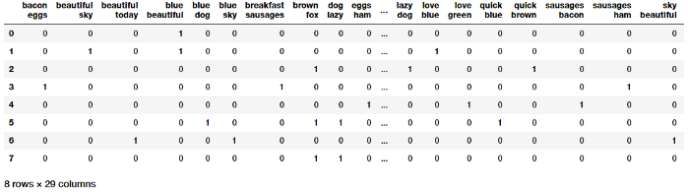
Bi-gram Model
Each feature consists of a bi-gram representing a sequence of two words and values represent how many times the bi-gram was present for our documents.

Slide 22
good movie movie did not a …
1 1 0 0 …..
1 1 0 1 …..
However, this table will come out to be very large, as there can be a lot of possible bigrams by considering all possible consecutive word pairs.
Using N-grams can result in a huge sparse matrix, if the size of the vocabulary is large.
Thus, we have to remove high-frequency N-grams, because they appear in almost all documents, generally articles, determiners, etc. most commonly called as StopWords.
We can also remove low frequency N-grams because these are really rare (i.e. generally appear in 1 or 2 reviews). These types of N-grams are generally typos(or typing mistakes).

Slide 23
Frequency of N-grams
Generally, medium frequency N-grams are considered as the most ideal.
However, there are some N-grams which are really rare in our corpus but can highlight a specific issue. Let’s suppose, a review that says – “Wi-Fi breaks often”.
Here, the N-gram ‘Wi-Fi breaks’can’t be too frequent, but it highlights a major problem that needs to be looked upon.
BoW model would not capture such N-grams since its frequency is really low.

Slide 24
TF-IDF Vectorizer
To solve this type of problem, we need another model i.e. tf-idf Vectorizer, which we will study next.
It uses a combination of two metrics in its computation, namely: term frequency (tf) and inverse document frequency (idf).
This technique was developed for ranking results for queries in search engines and now used for information retrieval model.
tf(t,d) = count of t in d / number of words in d
df(t) = occurrence of t in documents

Slide 25
Inverse Document Frequency(IDF)
While computing TF, all terms are considered equally important.
However it is known that certain terms, such as “is”, “of”, and “that”, may appear a lot of times but have little importance.
Thus we need to weigh down the frequent terms while scale up the rare ones.
IDF, an inverse document frequency factor is incorporated which diminishes the weight of terms that occur very frequently in the document set and increases the weight of terms that occur rarely.

Slide 26
Inverse Document Frequency
IDF is the inverse of the document frequency which measures the informativeness of term t.
When we calculate IDF, it will be very low for the most occurring words such as stop words (because stop words such as “is” is present in almost all of the documents.
N/df will give a very low value to that word).
This finally gives what we want, a relative weightage so
idf(t) = N/df

Slide 27
TF-IDF
tfidf(w, D) is the TF-IDF score for word w in document D.
tf(w, D) represents the term frequency of the word w in document D.
In case of a large corpus,say 100,000,000 , the IDF value explodes , to avoid the effect we take the log of idf .
idf(t) = log(N/(df + 1))
tf-idf(t, d) = tf(t, d) * log(N/(df + 1))

Slide 28
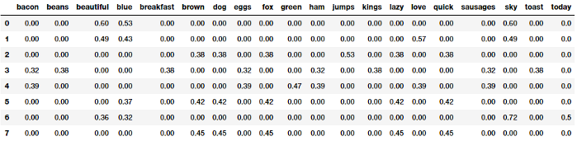
TF-IDF model based document feature vectors
The TF-IDF based feature vectors for each of our text documents show scaled and normalized values as compared to the raw Bag of Words model values.

Slide 29
Document similarity
Document similarity is the process of using a distance or similarity based metric that can be used to identify how similar a text document is with any other document(s) based on features extracted from the documents like bag of words or tf-idf.
Pairwise document similarity in a corpus involves computing document similarity for each pair of documents in a corpus.
For C documents in a corpus, a C x C matrix such that each row and column represents the similarity score for a pair of documents, which represent the indices at the row and column, respectively.

Slide 30
Similarity Measures
There are several similarity and distance metrics that are used to compute document similarity.
These include cosine distance/similarity, Euclidean distance, Manhattan distance, BM25 similarity, Jaccard distance and so on.
cosine similarity and compare pairwise document similarity based on their TF-IDF feature vectors.

Slide 31
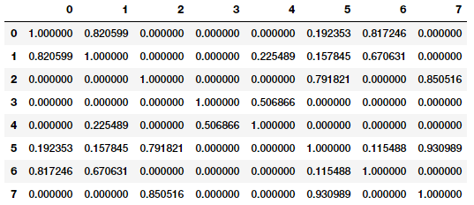
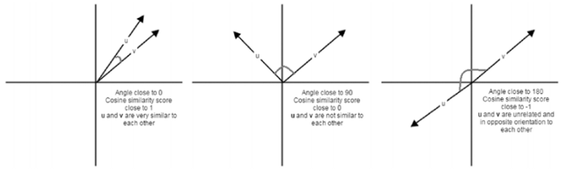
Cosine similarity basically gives us a metric representing the cosine of the angle between the feature vector representations of two text documents. Lower the angle between the documents, the closer and more similar they are.

Slide 32
similarity matrix
Documents (0, 1 and 6), (2, 5 and 7) are very similar to one another.
Documents 3 and 4 are slightly similar to each other but the magnitude is not very strong, however still stronger than the other documents.
This must indicate these similar documents have some similar features.
This is a perfect example of grouping or clustering that can be solved by unsupervised learning especially when you are dealing with huge corpora of millions of text documents.

Slide 33
Vector Space Representation
Each record of a dataset is represented by a high dimensional vector.
Vector representation models the dataset with many attributes.
High Dimensional Space is different from 2 or 3 dimensional spaces.
Each record is represented as a point in the space with its position depending on the attribute values.
In the vector space representation of data, properties such as dot product, distance between the vectors and orthogonality are natural interpretation.

Slide 34
Word vector model
Representing a document by a vector, each component of which corresponds to the number of occurrences of a particular word in the document.
The English language has on the order of 25,000 words, where a document is represented by a 25,000- dimensional vector.
The representation of a document, called the word vector model.
A collection of n documents represented by a collection of 25,000-dimensional vectors, one vector per document.
The vectors may be arranged as columns of a 25,000 × n matrix.

Slide 35
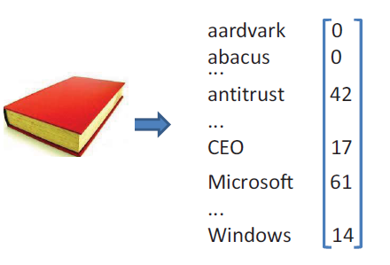
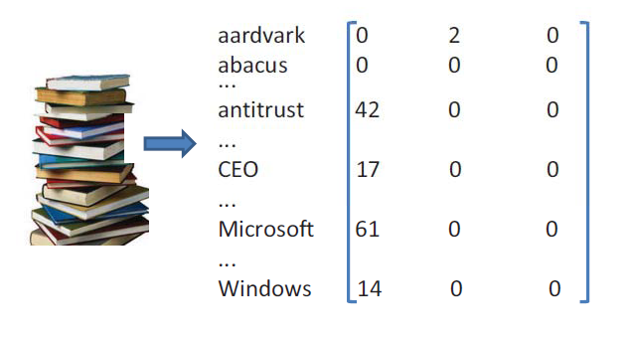

Slide 36
Measure Co-occurrence
One way to measure co-occurrence of words in two documents is to take the dot product of the vectors representing the two documents.
If the most frequent words in the two documents co-occur with similar frequencies, the dot product of the vectors will be close to the maximum.
If there is no co-occurrence, then the dot product will be close to zero.

Slide 37
After preprocessing the document vectors, we present the queries and find for each query the most relevant documents.
A query is represented by a vector which has one component per word, measures how important the word is to the query.
As a simple example, to find documents about cars that are not race cars, a query vector will have a large positive component for the word car and also for the words engine and perhaps door and a negative component for the words race, betting, etc.
1,000 products for sale and a large number of customers, recording the number of times each customer buys each product results in a collection of 1,000-dimensional vectors.
Here dot products represent relevance.

Slide 38
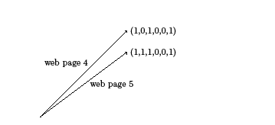
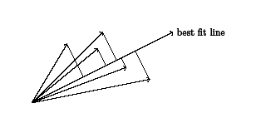
Consider a collection of n web pages that are linked.
A link is a pointer from one web page to another.
Each web page can be represented by a 0- 1 vector with n components where the jth component of the vector representing the i^{th} web page has value 1, if and only if there is a link from the i^{th} web page to the jth web page.

Slide 39
High Dimensional data
In traditional statistical data analysis, observations being vector of values measured on several variables :blood pressure, weight, height
We assumed many observations and a few selected variables which are well chosen to explain the phenomenon.
The trend today is more observations, and a very large number of variables.
The observations could be curves, images or movies so that a single observation has dimension in the thousands or millions or billions while only tens or hundreds of observations for study. This is HIGH DIMENSIONAL DATA.

Slide 40
Features of Images
While working on an image dataset we need to extract the features of different images which will help us segregate the images based on certain features or aspects.
There is a lot of information stored in images, and pre-processing them helps extract useful information.
Images are represented by pixels, therefore the number of features will be the same as the number of pixels (low level features).
The simplest way to create image features is to use these raw pixel values as separate features.
The features of an image may be the distinctive points, shape, size, orientation, etc.

Slide 41
Features of Images
A feature is a metric or some quantifiable value which is used to describe an image at high level perspective.
Features related to color, texture, shapes, color blobs, corners are contained in an image, middle level features.
The first step is to detect interest points in the image having the property of repeatability.
Color is a basic feature for image representation, and is
invariant with respect to scaling, translation and rotation of
an image.

Slide 42
Features of image
A certain region of the image has certain properties.
Features may be specific structures in the image such as points, edges or objects.
For example, a square has 4 corners and 4 edges, can be called features of the square, and help humans identify it’s a square.
A local image feature is a tiny patch in the image that's invariant to image scaling, rotation and change in illumination.
Distinctive to the image, so images with different structure will not have them.

Slide 43
Local Feature Detection and Description
Feature detection is finding interest points on an image and description is generating a vector representation for them.
Harris Corner Detection, Scale Invariant Feature Transform (SIFT), Speeded-Up Robust Features (SURF), Features from Accelerated Segment Test (FAST), and Binary Robust Independent Elementary Features (BRIEF).
Image features are, loosely speaking, salient points on the image. Ideally, features should be invariant to image transformations like rotation, translation and scaling.

Slide 44
Descriptors of features
Descriptors of feature points accompany the feature extraction and are used to compare between features extracted from different images.
Descriptors such as those of the SURF features allow us to link an object to a specific class, based on a similarity measure.
Studying the distribution of feature values of a specific class (type of PCB, objects like dogs, cats, faces, etc.) leads to classification using machine learning methodologies.

Slide 45
Object characterization
Object characterization by combination of features points and their associated descriptors.
Because features like peaks and edges focus on one aspect of the object, whereas SURF and binary features shed light on other aspects.
It is then the responsibility of the algorithm developers to make sense of the extracted features value, type and their relationship, in order to tailor a classification process.
Beyond classification, image features are used for object matching.
The possibility to reduce the dimensionality of an image or signal into several salient points, which characterize the image, leads to fast object comparison algorithms.

Slide 46
Features to support the tasks:
I. Matching image patches between images with significantly different viewpoints.
II. Extracting image landmarks; a) their (x, y) position,
III. Extracting image landmarks; b) their scale, and c) their orientation.
The problem of identifying a small patch in one image as corresponding to a specific patch in another image is called patch matching.
We wish to match a small patch rather than a single pixel, since the hope is that such a patch will be distinctive enough to be able to find it reliably in other images.

Slide 47
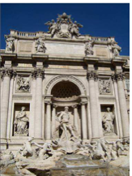
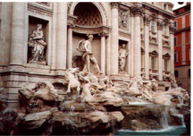
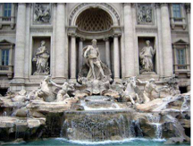
Image Patch Matching
The problem of identifying a small patch in one image as corresponding to a specific patch in another image is called patch matching.
Ma
Match a small patch rather than a single pixel, since the hope is that such a patch will be distinctive enough to be able to find it reliably in other images.

Slide 48
Difficulties Computing Image Correspondences
The lighting can vary.
The object’s pose might vary.
Image scale.
Image orientation
Partial occlusion or background clutter.

Slide 49
Template Matching
Template Matching is a high-level machine vision technique that identifies the parts on an image that match a predefined template.
Template Matching techniques are expected to address the following need: provided a reference image of an object (the template image) and an image to be inspected (the input image).
We want to identify all input image locations at which the object from the template image is present.

Slide 50
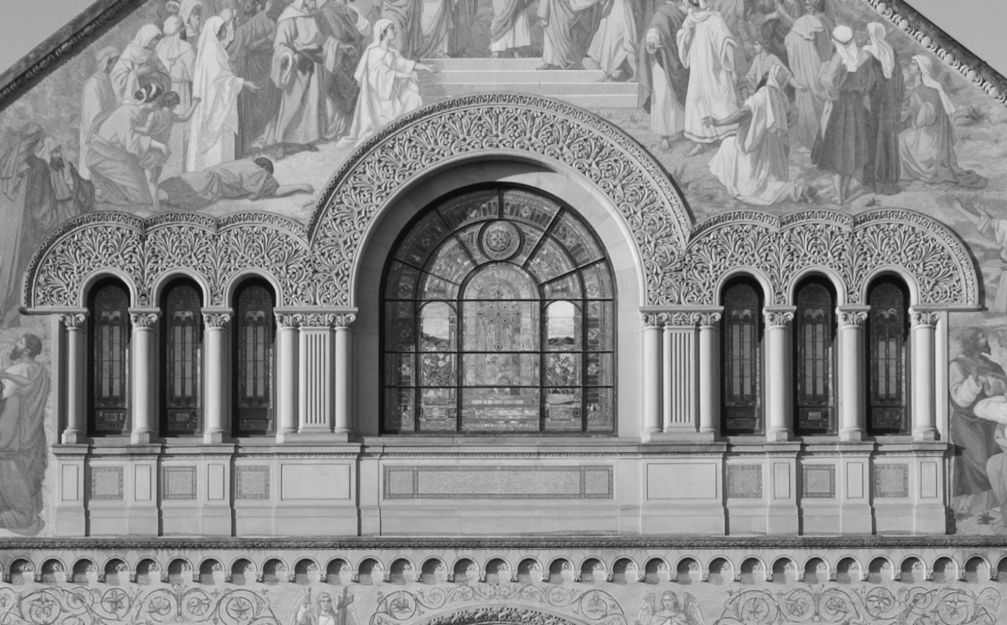

Template matching
Problem: locate an object, described by a template t[x,y], in the image s[x,y]
t[x,y]
s[x,y]
Search for the best match by minimizing mean-squared error.

Slide 51
Audio Features
In general, there are two types of audio features: physical and perceptual features.
Physical features refer to mathematical measurements computed directly from the sound wave: energy function, spectrum, cepstral coefficients and fundamental frequency.
Four audio feature sets differentiate five audio classes: popular music, classical music, speech, background noise and crowd noise.
The feature sets include low-level signal properties, mel-frequency spectral coefficients, and two new sets based on perceptual models of hearing.

Slide 52
Audio Feature Extraction
Audio signal to convert into an understandable format using feature extraction methods.
Feature extraction is required for classification, prediction and recommendation algorithms.
The MFCC feature extraction technique basically includes windowing the signal, applying the DFT, taking the log of the magnitude, and then warping the frequencies on a Mel scale, followed by applying the inverse DCT.
The mel scale (word melody) is a perceptual scale of pitches judged by listeners to be equal in distance from one another.

Slide 53
Pre-emphasis
A speech signal when recorded with a microphone from a distance has approximately a −6 dB/octave slope downward compared to the true spectrum of the vocal tract.
Therefore, pre-emphasis removes some of the noisy effects from the vocal tract parameters.
Pre-emphasis refers to filtering, that emphasizes the higher frequencies.
Its purpose is to balance the spectrum of voiced sounds that have a steep roll-off in the high-frequency region.

Slide 54


Each windowed frame is converted into magnitude spectrum by applying DFT.
N is the number of points used to compute the DFT.
Mel spectrum is computed by passing the Fourier transformed signal through a set of band-pass filters known as Mel-filter bank.
Mel is a unit of measure based on the human ears perceived frequency.
The approximation of Mel from physical frequency:
f denotes the physical frequency in Hz, and f _{Mel} denotes the perceived frequency.

Slide 55
Discrete cosine transform (DCT)
Since the vocal tract is smooth, the energy levels in adjacent bands tend to be correlated.
The DCT is applied to the transformed Mel frequency coefficients to obtain cepstral coefficients.
Prior to computing DCT, the Mel spectrum is usually represented on a log scale.
Since most of the signal information is represented by the first few MFCC coefficients, the system can be made robust by extracting only those coefficients ignoring or truncating higher order DCT components.

Slide 56
Dynamic MFCC features
The cepstral coefficients are usually referred to as static features, since they only contain information from a given frame.
The extra information about the temporal dynamics of the signal is obtained by computing first and second derivatives of cepstral coefficients.
The first-order derivative is called delta coefficients, and the second-order derivative is called delta–delta coefficients.
Delta coefficients talk about the speech rate, and delta–delta coefficients provide information like acceleration of speech.

Slide 57
Video Feature
Videos are one of the most interesting datasets such as social networks or genetic codes, described as a stack of images
Video uploading platforms such as YouTube are collecting enormous datasets, empowering Deep Learning research.
Two immediate concerns relating to the video datasets used.
The first is the enormous size of the dataset, making the prospect of loading the entire dataset into local memory impractical.
Computing cluster, Parallel computing

Slide 58
Video Feature
A second concern with this dataset is one which is frequently found with text mining applications, the variable length of each instance.
For example, one video might be 30 seconds, while another is 2 minutes.
In text, this is solved by 0 padding the ends of text such that all inputs are of the same length.
Videos are typically recorded at 30 frames per second.

Slide 59
High dimensional images
Three- and four dimensional data, such as 3D images and videos, are becoming a commodity in multimedia systems.
Understanding and utilizing these data are the leading edge of modern computer vision.
Traditional methods vary a lot depending on the application and the type of data they are applied on.
For example, when dealing with semantic segmentation the most common, non-deep, approach is to apply a graph model like a conditional random field (CRF).
On the other hand, a large group of works utilize template matching approaches in order to tackle object detection.

